Slide 1



THE
STOCK PICKER
Fangjun Liu fl2413
Yunfan Zhang yz2866
Zhuangfei Yang zy2233
Zimeng Ji zj2194

Slide 2






Overview
STOCK PICKER
Basic Analysis
Calculated return rate, beta and alpha values of stocks in each sector and analyzed price fluctuation in each sector
Evaluated the empirical law of beta variance in different cyclical industries
Stock Picking Strategy I
Designed 2 scoring formulas consists of beta and alpha
Built the portfolio, including ≤ 3 stocks with highest scores from each sector
Tested the strategy, can we beat the market?
Stock Picking Strategy II
Rebuilt portfolio every week automatically according to previous return.
Use number of news to predict the market
Used Selenium to mimic searching news in NewYorkTimes during specific period, thereby get the weekly number of positive/negative news.
Evaluated the relationship between weekly number of positive/negative news and one month later 30 days average return of SP500 every 7 days
1
of
17

Slide 3

WHY
STOCK PICKER
Stock Investment…
Financial Data…
This topic is appealing !
2
of
17

Slide 4






WHY
STOCK PICKER
These packages are high-performance and handy !
3
of
17

Slide 5
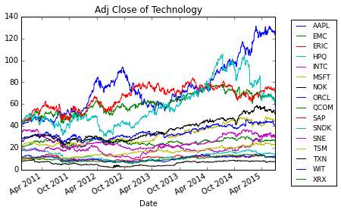
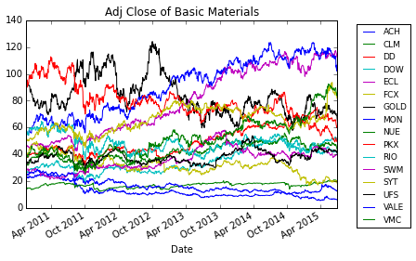
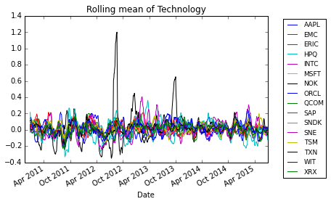
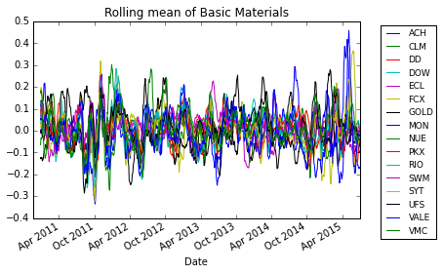
Price fluctuation
Technology
Basic Materials
4
of
17

Slide 6
Beta for stocks in each sectors
Sector | 1 | 2 | 3 | 4 | 5 | 6 | 7 | 8 | 9 | 10 | 11 | 12 | 13 | 14 | 15 | 16 | Mean
Technology | 0.935 | 1.238 | 1.746 | 1.800 | 1.017 | 0.951 | 1.017 | 1.418 | 0.978 | 1.192 | 1.350 | 1.304 | 1.396 | 1.770 | 1.243 | 1.526 | 1.305
Basic Materials | 1.299 | 1.346 | -0.048 | 1.109 | 1.447 | 0.982 | 1.396 | 1.649 | 1.276 | 0.949 | 1.083 | 0.605 | 1.002 | 1.370 | 0.417 | 0.968 | 1.053
Communication | 1.248 | 0.738 | 1.228 | 0.121 | 0.976 | 0.447 | 1.267 | 0.432 | 1.070 | 1.178 | 0.646 | 1.039 | 0.425 | 0.350 | 1.310 | 1.142 | 0.851
Nonperiodic Consumption | 0.509 | 0.839 | 0.734 | 0.249 | 0.432 | 1.042 | 0.485 | 0.408 | 0.643 | 0.851 | 0.430 | 0.346 | 0.635 | 0.625 | 1.161 | 0.781 | 0.636
Energy | 0.956 | 1.009 | 0.969 | 1.392 | 1.242 | 1.271 | 0.781 | 1.015 | 1.414 | 1.448 | 1.526 | 0.827 | 1.060 | 1.469 | 1.114 | 1.030 | 1.158
Industry | 1.326 | 1.011 | 1.207 | 1.344 | 1.030 | 0.908 | 0.907 | 1.162 | 0.943 | 1.121 | 1.205 | 1.011 | 1.295 | 0.919 | 0.837 | 1.393 | 1.101
Finance | 0.981 | 1.212 | 2.130 | 1.050 | 2.065 | 1.289 | 1.262 | 1.525 | 1.043 | 0.930 | 1.480 | 2.063 | 1.836 | 1.012 | 1.506 | 1.288 | 1.417
Periodic Consumption | 1.094 | 0.464 | 0.954 | 0.323 | 0.755 | 1.138 | 1.354 | 1.567 | 1.698 | 0.627 | 0.627 | 0.752 | 1.283 | 0.709 | 1.279 | 1.720 | 1.011
Utilities | 0.344 | 0.464 | 0.165 | 0.240 | 0.066 | 0.765 | 0.345 | 0.256 | 0.440 | 0.492 | 0.301 | 0.253 | 0.454 | 0.040 | 0.275 | 0.216 | 0.320
5
of
17

Slide 7
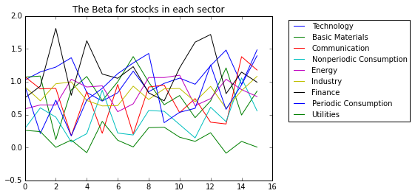
Cyclical industries
6
of
17

Slide 8
Alpha for stocks in each sectors (sp500)
……
Cyclical industries
7
of
17

Slide 9
Strategy I
When the market goes up, select stocks with beta>1 and alpha>0
When the market goes down, select stocks with beta<1 and alpha>0 or stocks with beta<0.
Designed scoring formulas consists of beta and alpha for up and down period respectively
UP
Score = mean_alpha_list[i][j]*1000*0.7 + beta_list[i][j]*10*0.3
Down
Score = mean_alpha_list[i][j]*1000*0.7 - beta_list[i][j]*10*0.3
Built two portfolios (market goes up/down), each one includes ≤2 or ≤3 stocks from every sectors
8
of
17

Slide 10
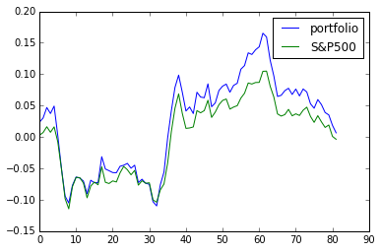
Ticker | Sector
SNDK | Technology
NOK | Technology
VMC | Basic Materials
DOW | Basic Materials
DIS | Communication
TWX | Communication
NVO | Nonperiodic Consumption
CELG | Nonperiodic Consumption
NOC | Industry
HON | Industry
PUK | Finance
BAC | Finance
LUV | Periodic Consumption
LOW | Periodic Consumption
Testing strategy I —— Market goes up
The portfolio
Evaluate the performance of the portfolio starting from 7/1/2015 till recently.
excess return rate = 0.9390243902439024
9
of
17

Slide 11
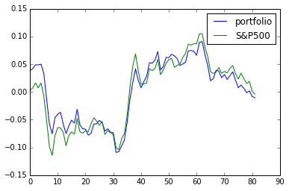
Testing strategy I —— Market goes down
Ticker | Sector
ECL | Basic Materials
VOD | Communication
MA | Nonperiodic Consumption
AMGN | Nonperiodic Consumption
BMY | Nonperiodic Consumption
TJX | Periodic Consumption
NEE | Utilities
SRE | Utilities
The portfolio
Evaluate the performance of the portfolio starting from 7/1/2015 till recently.
10
of
17

Slide 12
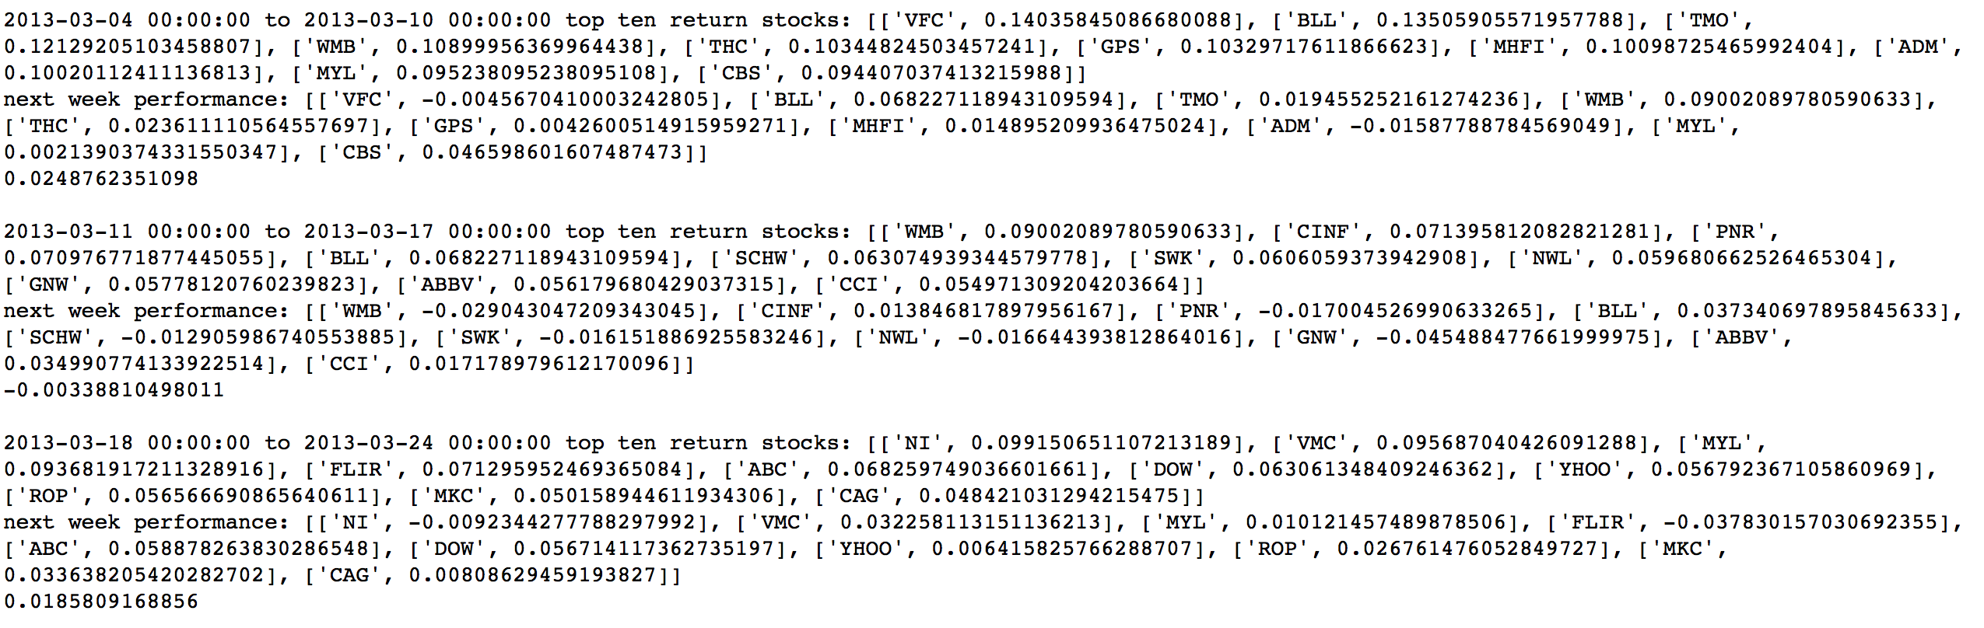
Strategy II
Automatically Find top 10 return stocks every week from 2011 to today and choose them as portfolio next week.
An example of the output of our program.
11
of
17

Slide 13
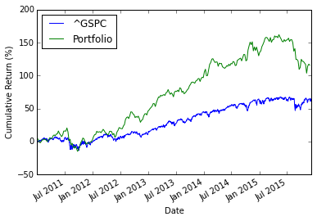
Strategy II
The result is quite encouraging!
Total return is 115.80%.
Annualized rate of return is 16.93%
12
of
17

Slide 14
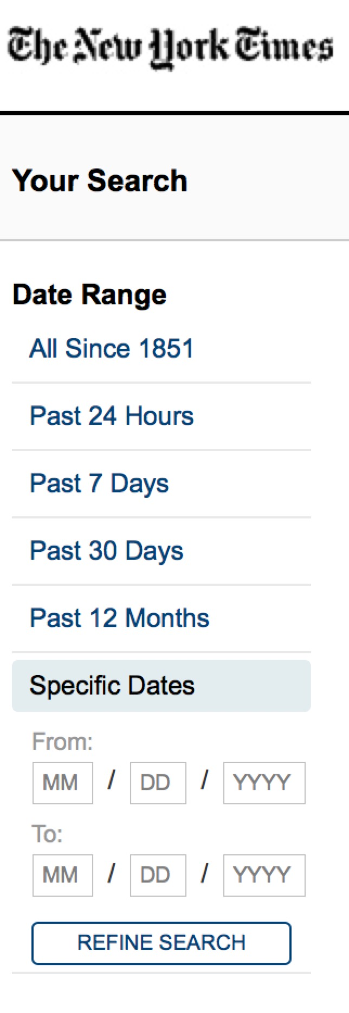
Can number of news predict the market?
Mimic users searching news in NewYorkTimes with selected keywords and specific period (Selenium).
Set “positive”keywords to find weekly number of positive news each year from 2011 to 2015: searchstring=‘economy OR market recover OR boost OR positive OR rebound OR improve OR stimulate’
Set “negative”keywords to find weekly number of negative news each year from 2011 to 2015: searchstring=‘economy OR market decline OR disppointed OR breakdown OR slowdown OR suffer’
Explored the relationship between Number of positive/negative news and One month later 30 days average return of SP500 every 7 days
13
of
17

Slide 15
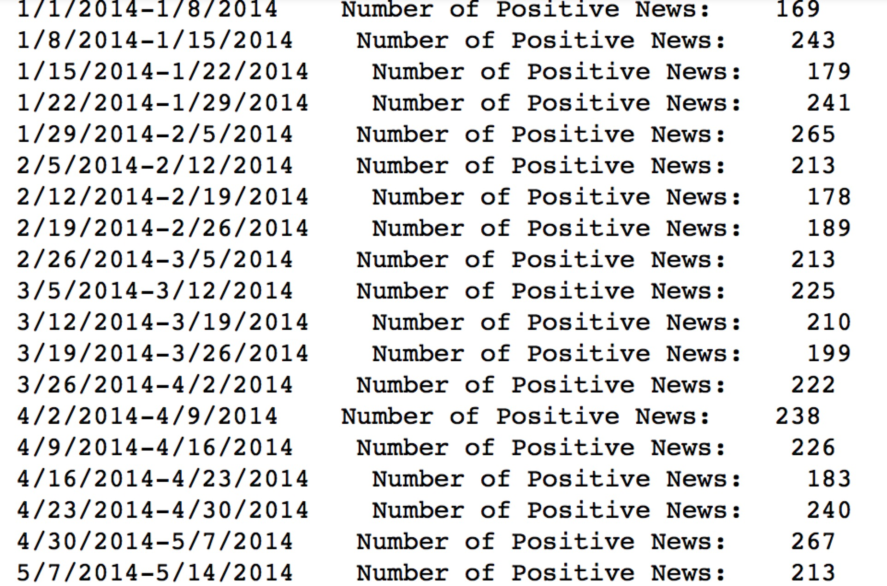
Sample output data
weekly number of positive news in 2014
14
of
17

Slide 16
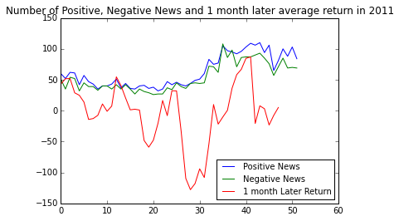
To evaluate the relationship Let’s Plot !
15
of
17

Slide 17
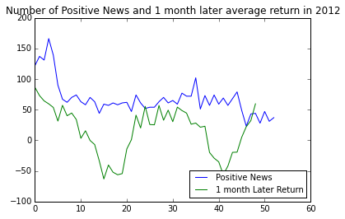
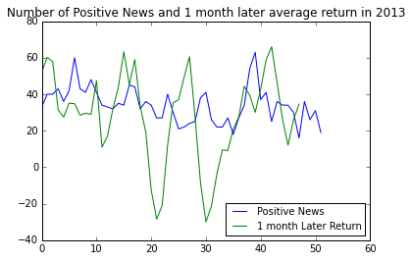
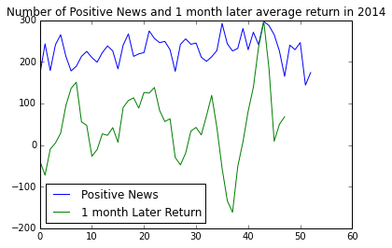
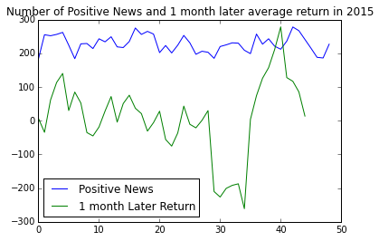
To evaluate the relationship Let’s Plot !
16
of
17

Slide 18
Data Source：
Yahoo Finance
NewYorkTimes
Libraries we used：
pandas
matplotlib
numpy
re
urllib
selenium
beautifulsoup
datetime
17
of
17

Slide 19
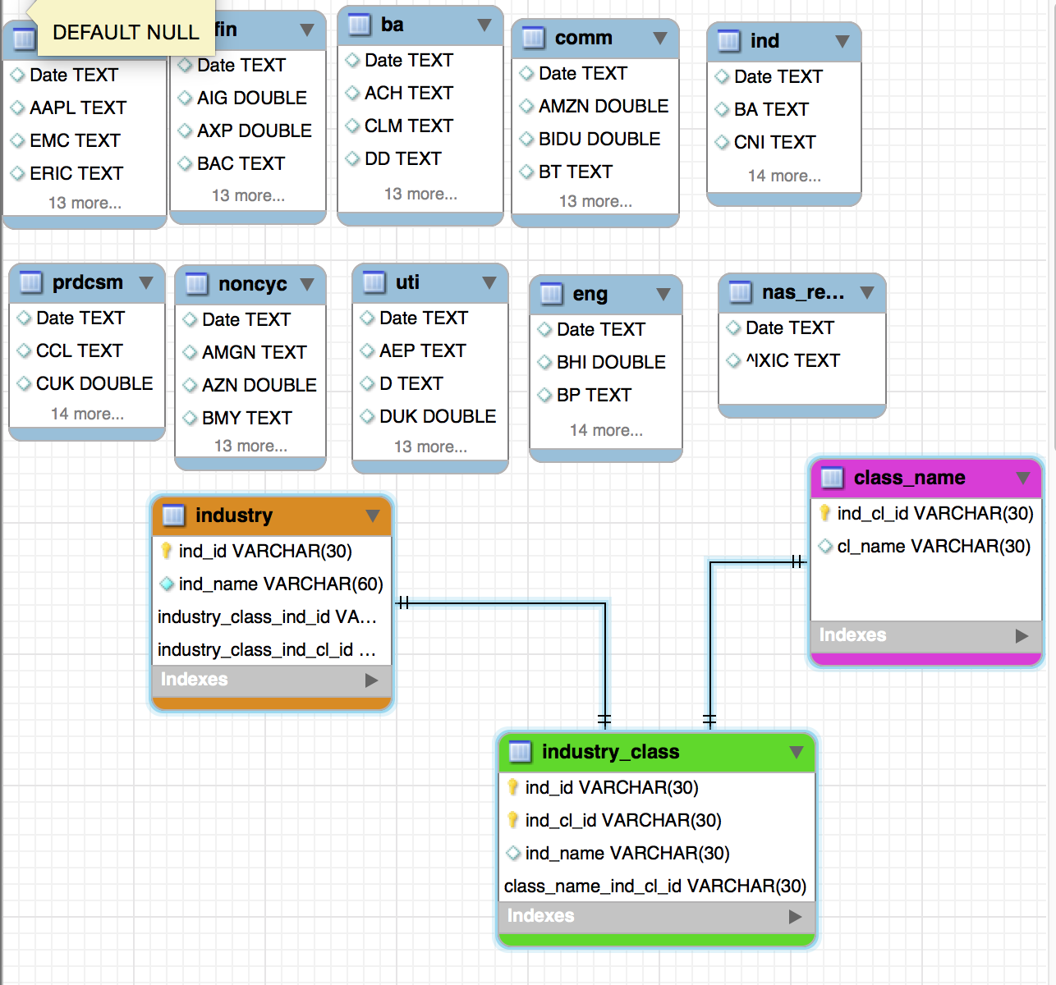
E-R Model
17
of
17

Slide 20
THANK YOU
Fangjun Liu fl2413
Yunfan Zhang yz2866
Zhuangfei Yang zy2233
Zimeng Ji zj2194

